Slide 1
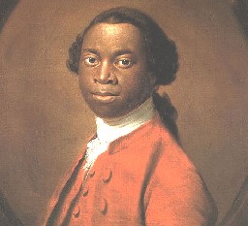
Olaudah Equiano

Slide 2
c. 1745 - 1797
Also known as Gustavus Vassa
African involved in the movement for the abolition of the slave trade
The Interesting Narrative of the Life of Olaudah Equiano

Slide 3
Early Life
Born in 1745 in what is now Nigeria
Kidnapped at 11 and sold to slaveholders
Sent to West Indies and then Virginia
Bought by Michael Pascal, a navy lieutenant

Slide 4
Life
Describes the horror of slavery
“Iron muzzle” - unable to speak or eat
Tried scrubbing his face as a boy – ashamed of himself
Sold to Robert King, who told him he could buy his freedom for 40 pounds

Slide 5
Slave Narratives
Autobiography/Memoir
First influential slave autobiography
Book fueled a growing anti-slavery movement in the US and Britian
Made readers see slaves as people similar to themselves

